Slide 1


PARUL INSTITUTE OF TECHNOLOGY
FACULTY OF ENGINEERING & TECHNOLOGY
PARUL UNIVERSITY
CARRO
VEHICLE RENTAL SYSTEM
Presented By: Hrithik Mani Tripathi(210306105215), Aniket kumar(210306105258)
Ishan Pandey(210306105251) , Himanshi Jaiswal(210306105250)
Supervisors: Mr.Arpita Vaidhya.
PARUL INSTITUTE OF TECHNOLOGY, PARUL UNIVERSITY
PARUL INSTITUTE OF TECHNOLOGY, PARUL UNIVERSITY

Slide 2
Content of Presentation
Abstract
Introduction
Problem Statement
Project Module
Literature Review (Features)
Proposed Methodology
Use case diagram/ER diagram/Flow diagram
Hardware and software Requirement
Expected Outcome of the Project
Limitation
Conclusion and Future Work
References
PARUL INSTITUTE OF TECHNOLOGY, PARUL UNIVERSITY
PARUL INSTITUTE OF TECHNOLOGY, PARUL UNIVERSITY

Slide 3
Abstract
CARRO introduces about Car Rental System, which aims to develop an efficient and user-friendly application for renting cars.
This system streamlines the process of renting cars by providing an online platform for customers to browse available vehicles, make reservations, and manage bookings.
This presentation outlines the various aspects of the Vehicles Rental System, including its objectives, problem statement, proposed methodology, project modules, diagrams, and advantages.
PARUL INSTITUTE OF TECHNOLOGY, PARUL UNIVERSITY
PARUL INSTITUTE OF TECHNOLOGY, PARUL UNIVERSITY

Slide 4
Introduction
With CARRO, you can experience a streamlined way of getting any vehicle. The Vehicles Rental System is a web-based application that allows customers to rent vehicles online.
The objective of this project is to create a system that simplifies the process of renting and managing vehicles for customers and the rental company..
It provides a user-friendly interface for customers to search, book, and manage their car rentals as per their needs.
PARUL INSTITUTE OF TECHNOLOGY, PARUL UNIVERSITY
PARUL INSTITUTE OF TECHNOLOGY, PARUL UNIVERSITY

Slide 5
Problem Statement
The traditional car rental process involves manual paperwork, which can be time-consuming and prone to errors.
Sometimes, the customers often face difficulties in finding available cars and making reservations through physical visits.
This project aims to address these challenges by developing a digital solution that simplifies car rental operations and enhances the customer experience
PARUL INSTITUTE OF TECHNOLOGY, PARUL UNIVERSITY
PARUL INSTITUTE OF TECHNOLOGY, PARUL UNIVERSITY

Slide 6
Project Module
Vehicle Reservation and Booking
User Registration and Authentication
Easy to Give and Borrow
Vehicle Catalogs
User Profile and History
Payment Gateway Integration
GPS tracking
Availability Calendar
User Reviews,Ratings and Reports
PARUL INSTITUTE OF TECHNOLOGY, PARUL UNIVERSITY
PARUL INSTITUTE OF TECHNOLOGY, PARUL UNIVERSITY

Slide 7
PROPOSED METHODOLOGY
CARRO is a car rental system, an appropriate Software Development Life Cycle (SDLC) model to consider is the Agile model, specifically the Scrum framework. The Agile approach is well-suited for projects that require flexibility, collaboration, and iterative development. Here's why Agile/Scrum can be a good fit for a car rental system Flexibility and Adaptability: Agile allows for changes and refinements throughout the development process. As car rental systems often have evolving requirements and market demands, Agile enables you to respond to these changes effectively. While Agile/Scrum is a commonly used SDLC model, it's important to assess your specific project needs, team capabilities, and stakeholder requirements. You may also consider other models such as Kanban or Lean if they align better with your circumstances. Adapt the chosen model to suit your car rental system's unique needs, ensuring a well-functioning development process.
PARUL INSTITUTE OF TECHNOLOGY, PARUL UNIVERSITY
PARUL INSTITUTE OF TECHNOLOGY, PARUL UNIVERSITY

Slide 8
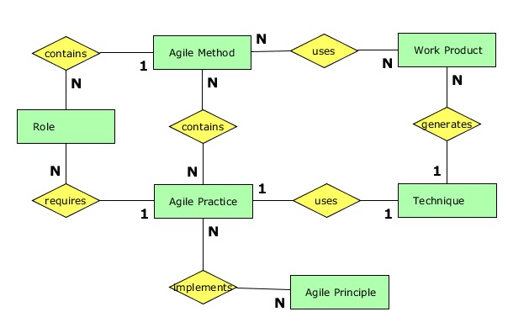
PROPOSED METHODOLOGY
PARUL INSTITUTE OF TECHNOLOGY, PARUL UNIVERSITY
PARUL INSTITUTE OF TECHNOLOGY, PARUL UNIVERSITY

Slide 9
Technologies Used
Employ HTML, CSS, and JavaScript for front-end & ReactJS
Back-end: Node.js, Express.js
Database: MongoDB
Payment Integration: Stripe.
PARUL INSTITUTE OF TECHNOLOGY, PARUL UNIVERSITY
PARUL INSTITUTE OF TECHNOLOGY, PARUL UNIVERSITY

Slide 10
ADVANTAGES
Highlight the advantages of the Car Rental System:
*Convenient and time-saving car booking process for customers .
*Real-time availability status of cars for efficient decision-making .
*Secure and easy online payment options for enhanced user experience .
*Comprehensive booking management for administrators .
*Automated reminders and notifications for users .
*Data-driven insights and reports for business analysis .
*Reduced paperwork and improved operational efficiency for car rental businesses.
PARUL INSTITUTE OF TECHNOLOGY, PARUL UNIVERSITY
PARUL INSTITUTE OF TECHNOLOGY, PARUL UNIVERSITY

Slide 11
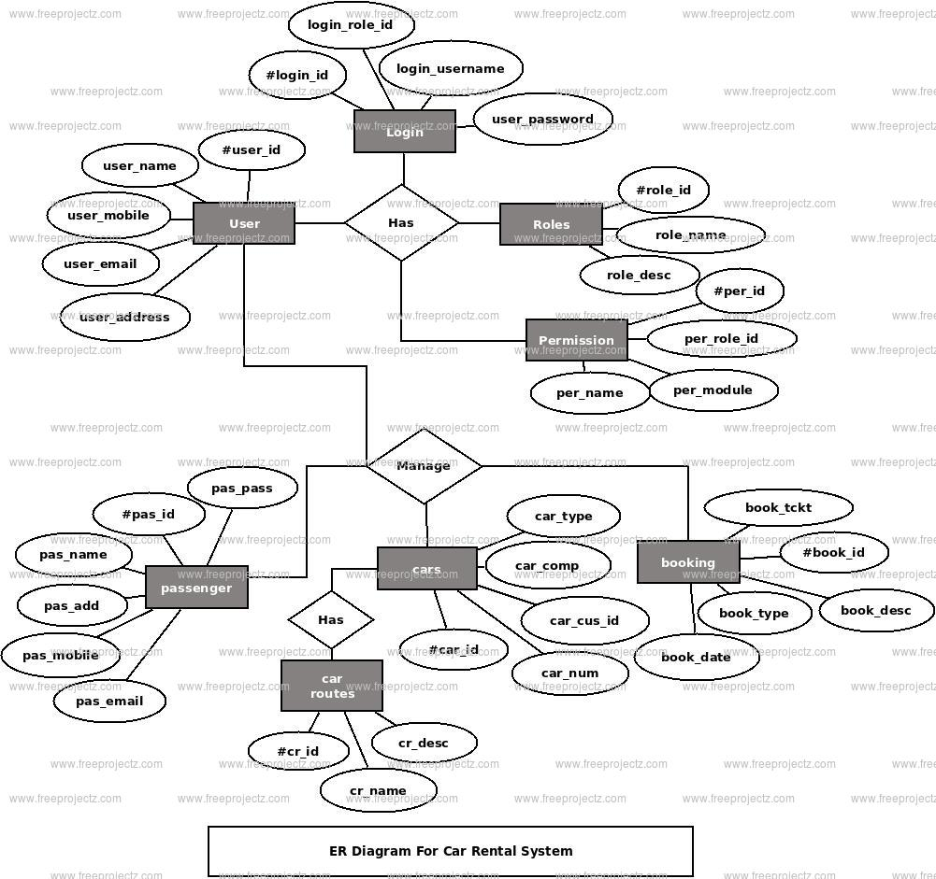
ER MODEL
PARUL INSTITUTE OF TECHNOLOGY, PARUL UNIVERSITY
PARUL INSTITUTE OF TECHNOLOGY, PARUL UNIVERSITY

Slide 12
Hardware & Software Requirements
HARDWARE :
SOFTWARE :
Developer Side:
  Multi-core processor (e.g., Intel Core i3 or higher)
  Minimum 2GB RAM
  Sufficient storage capacity
Client/User Side:
  Desktop Computers (Windows, macOS, Linux)
  Laptops (Windows, macOS, Linux)
  Tablets and Smartphones (iOS, Android)
Operating System:
  Developer: Linux-based OS or Windows Server for hosting the web application.
  Clients/Users: Compatible with major operating systems (Windows, macOS, Linux).
Networking:
  Stable internet connection (minimum 1Mbps speed)
PARUL INSTITUTE OF TECHNOLOGY , PARUL UNIVERSITY
PARUL INSTITUTE OF TECHNOLOGY, PARUL UNIVERSITY

Slide 13
Expected Outcome of the Project
User-Friendly Interface: Create an intuitive and user-friendly web-based application that allows customers to easily search, select, and book rental vehicles based on their preferences and requirements.
Real-Time Vehicle Availability: Implement a robust system that provides real-time information about vehicle availability, ensuring customers can access up-to-date data and make informed decisions while making reservations.
Secure Online Payments: Integrate a secure payment gateway that enables customers to make online payments for their reservations, providing a seamless and safe transaction experience.
Reservation Management: Develop a reservation management system that allows customers to view, modify, and cancel their bookings while ensuring the availability of vehicles is accurately updated in the system
PARUL INSTITUTE OF TECHNOLOGY, PARUL UNIVERSITY
PARUL INSTITUTE OF TECHNOLOGY, PARUL UNIVERSITY

Slide 14
Expected Outcome of the Project
Admin Control Panel: Create an admin control panel that empowers rental companies to manage vehicle inventory, track reservations, view customer data, and generate relevant reports.
Vehicle Tracking and Management: Explore the possibility of incorporating GPS technology to track vehicle locations, monitor mileage, and manage maintenance schedules efficiently.
Customer Feedback and Reviews: Implement a customer feedback and review system to gather valuable insights and improve the overall quality of service
PARUL INSTITUTE OF TECHNOLOGY, PARUL UNIVERSITY
PARUL INSTITUTE OF TECHNOLOGY, PARUL UNIVERSITY

Slide 15
Conclusion and future Work
Conclusion:
CARRO aims to revolutionize the Vehicle reservation and management experience with its user-friendly interface.
The use of front-end technologies enables a convenient and personalized Booking experience.
Future Work:
Integration of higher level of backend and database systems to enhance functionality and scalability..
Creation of Mobile Application to further increase the userbase reach.
PARUL INSTITUTE OF TECHNOLOGY, PARUL UNIVERSITY
PARUL INSTITUTE OF TECHNOLOGY, PARUL UNIVERSITY

Slide 16
References
PARUL INSTITUTE OF TECHNOLOGY, PARUL UNIVERSITY
PARUL INSTITUTE OF TECHNOLOGY, PARUL UNIVERSITY

